Slide 1
P1: Graph based Fraud Detection
By: Akanksha Satya & Jonathan Urena Salazar

Slide 2
Data ingestion into Neo4j graph
Graph modeling (accounts + transactions)
Fraud detection signals
Star schema transformation
Power BI dashboard
Project Journey

Slide 3

Problem & Motivation
Why Fraud Detection Matters?
Fraud is rarely isolated behavior
Often involves networks of accounts
Traditional row-based analysis misses relationships

Slide 4

Graph Model
Nodes → Accounts
Edges → Transactions
Captures flow of money between entities

Slide 5
Detection Signal Overview
Transfer → Cash-Out
Fan-In / Fan-Out
Drain Behavior
Dense Communities (Rings)
Guilt by Association
Rapid Movement Pattern
Transfer followed by cash-out within 1–2 steps
Strong indicator of fraud behavior
Unusual Connectivity
Accounts with abnormal number of connections
Threshold: > 3 standard deviations above mean
Grouped by time step for short-term spikes
Rapid Outflow
Account receives funds
Quickly transfers them out
Time window: 10 steps
Coordinated Groups
Louvain clustering used to detect communities
Small groups (3–15 accounts)
High internal transaction volume
High internal/external ratio
Network-Based Detection
Accounts flagged if connected to flagged accounts
Threshold: ≥ 1 flagged neighbor
A risk score was calculated per each signals weigh contribution.

Slide 6

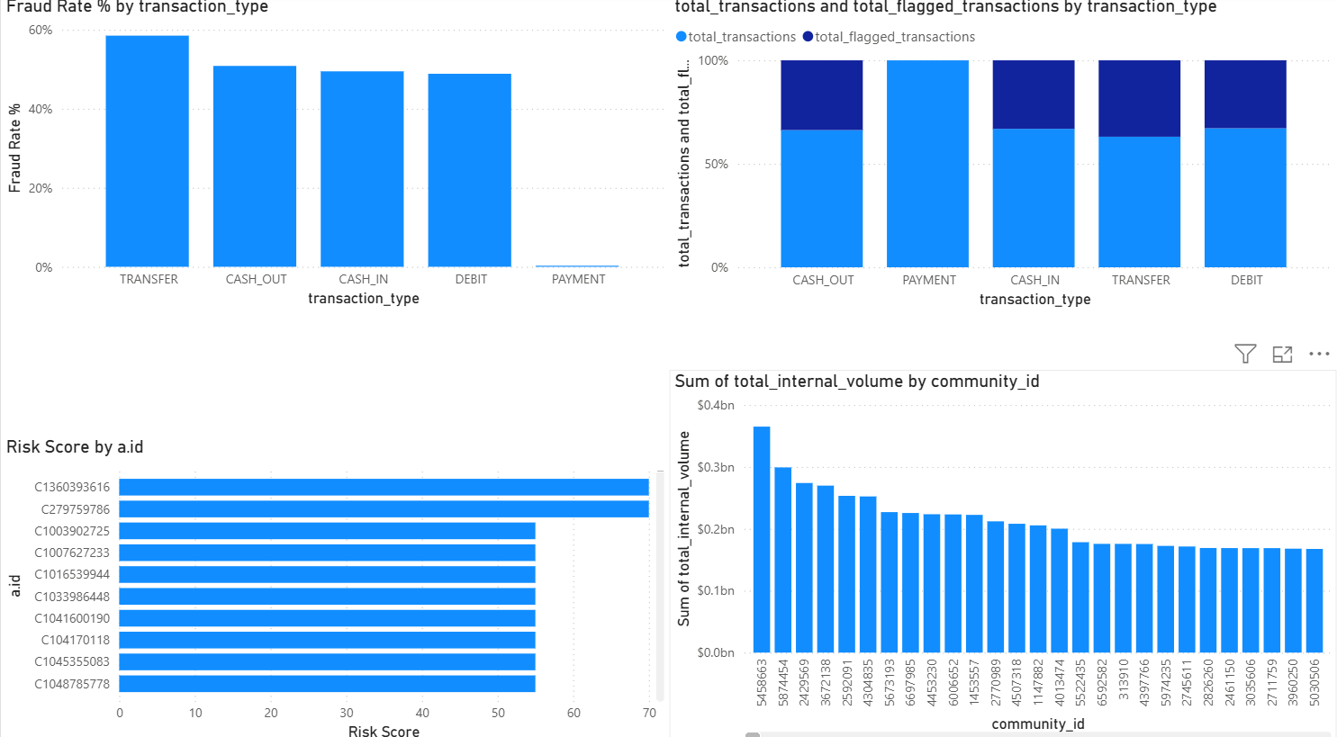
Power BI Dashboard Walkthrough

Slide 7
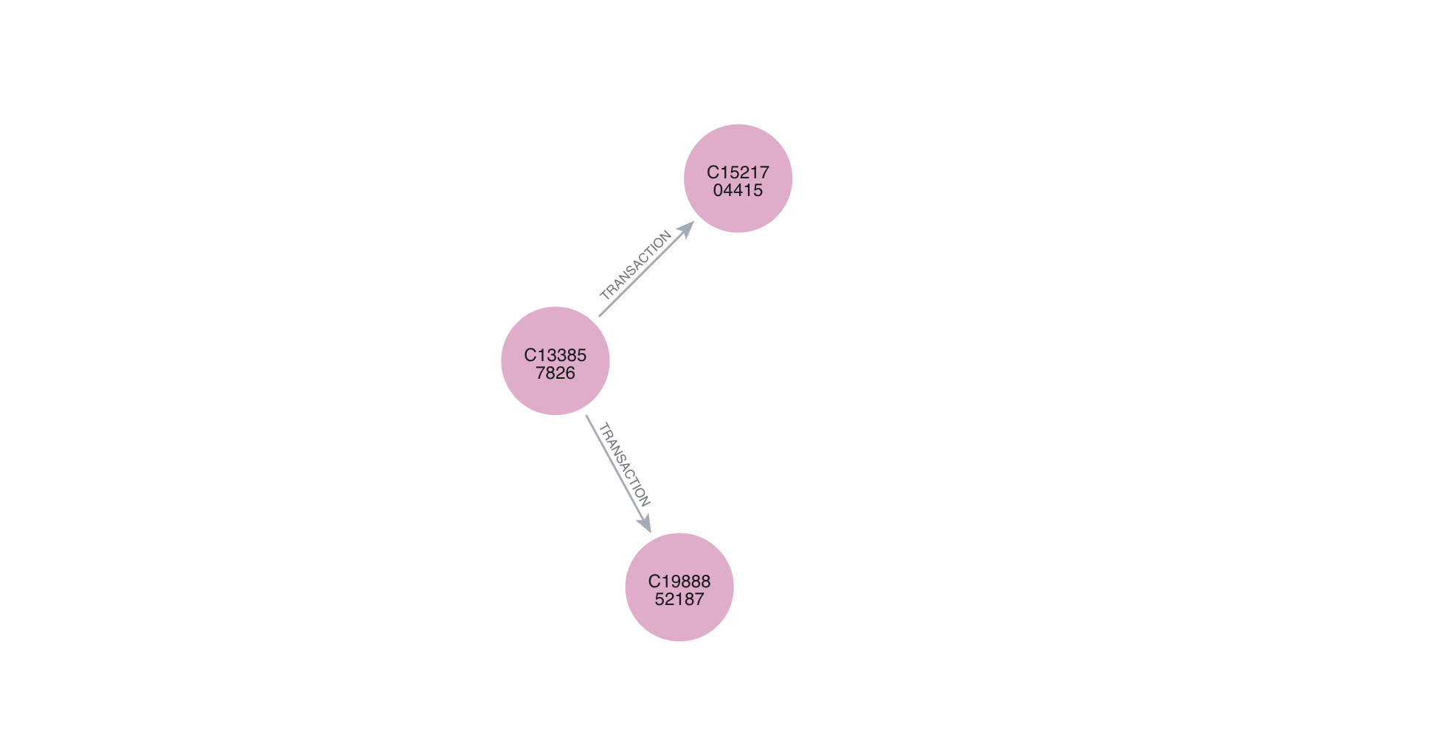
Case Study #1: Fan-Out Behavior
Account: C133857826
Step: 17
Sent to 2 receivers in same time step
Pattern: Fan-Out
Suggests fund distribution behavior
Receiver
Sender
Why it matters?
Unusual compared to normal one-to-one transactions
Receiver

Slide 8
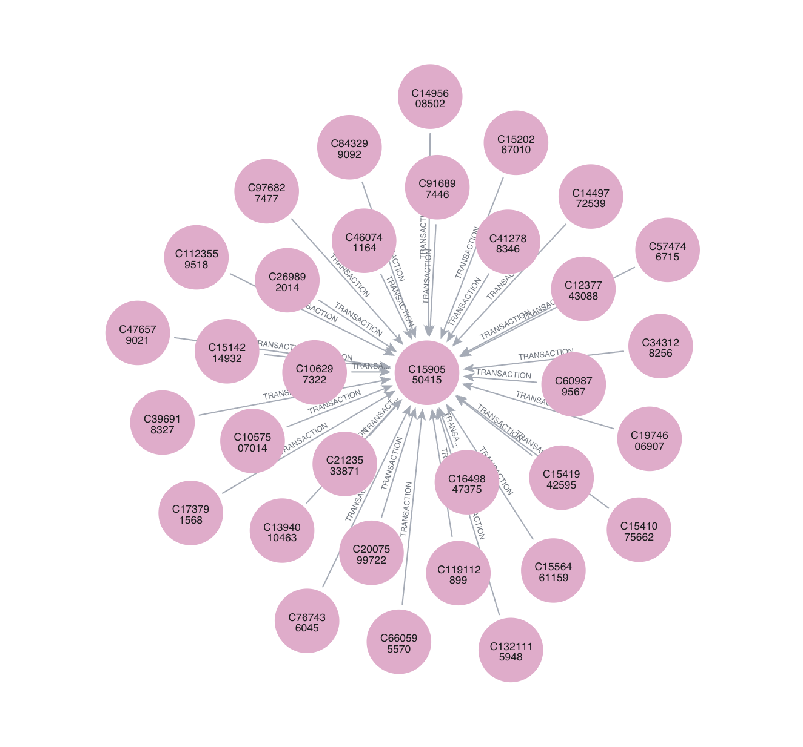
Case Study #2: Fan-In Behavior
Source Accounts
Account: C1590550415
Step: 1
Received from 32 unique accounts
Pattern: Fan-In (Aggregation)
Indicates centralized fund collection
Target Account
Why it matters?
Unusually high number of incoming transactions in a short time window

Slide 9
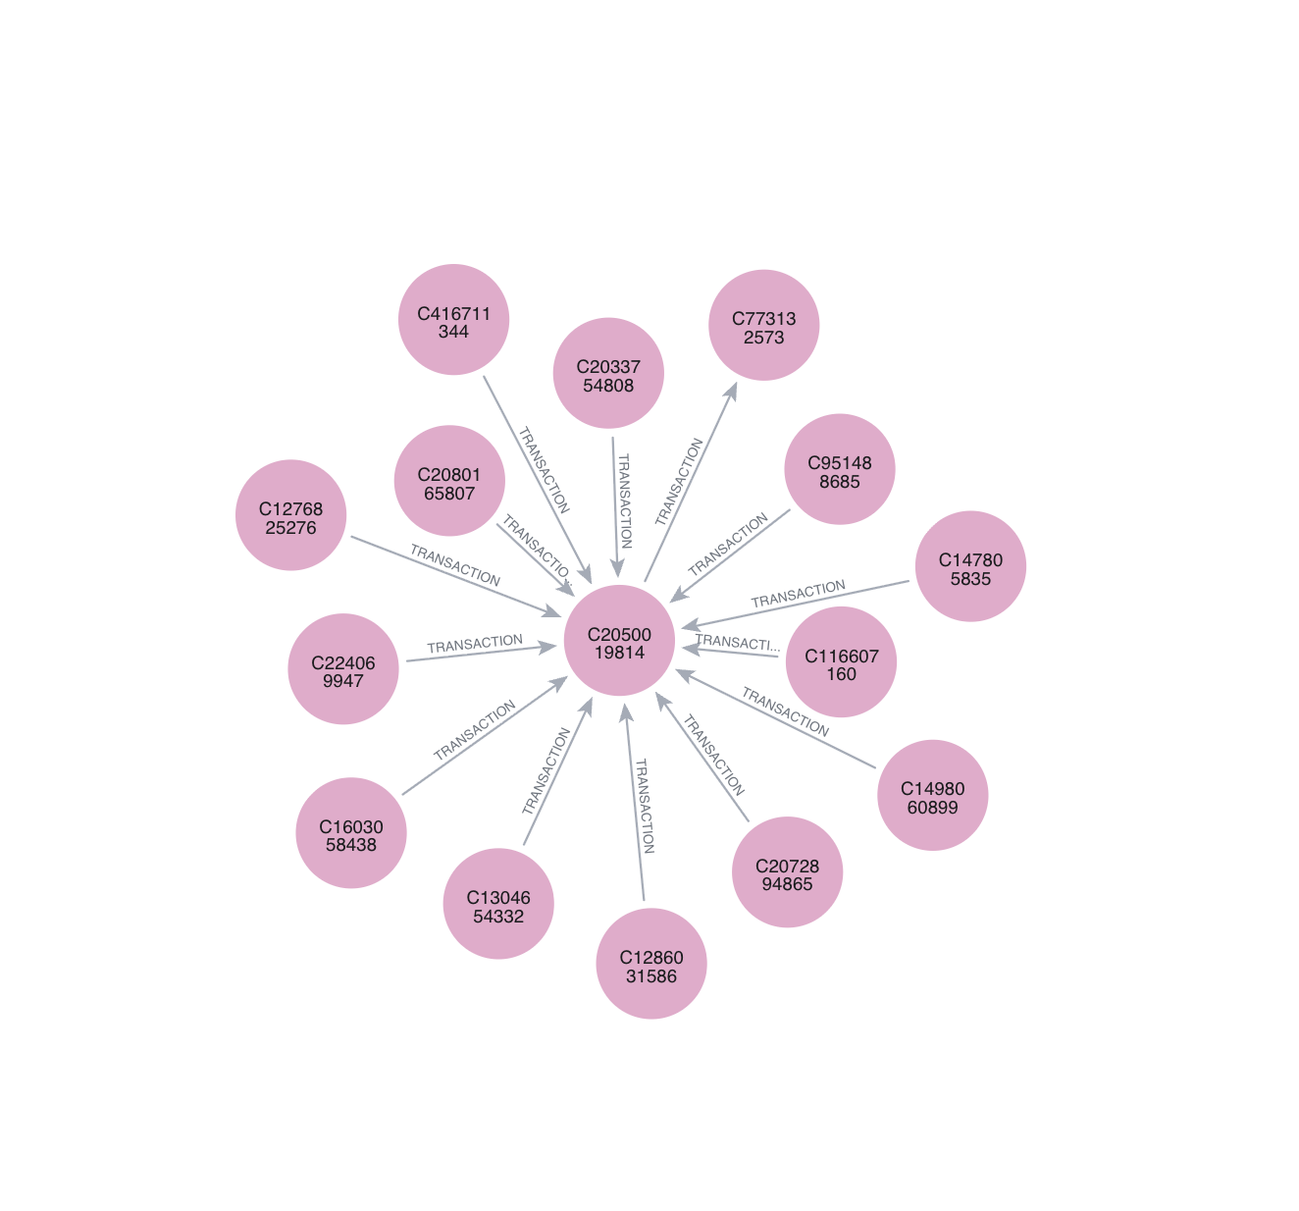
Case Study #3: Drain Behavior
Destination
Account: C2050019814
Receives funds from multiple sources
Quickly transfers funds out
Time window: ≤ 10 steps
Leaves very low remaining balance
Pattern: Drain (Pass-through behavior)
Draining Account
Why it matters?
Acts as an intermediary rather than a final destination
Sources

Slide 10
Case Study Summary
Fan-Out (Distribution)
One account sends funds to multiple recipients
Suggests fund splitting / layering
Fan-In (Aggregation)
Multiple accounts send funds to one account
Indicates centralized collection (hub)
Drain Behavior (Intermediary)
Account receives and quickly transfers funds
Suggests pass-through / laundering activity
Fan-In
Drain
Fan-Out
Fraud is not a single action; it is a coordinated flow of funds across multiple accounts.

Slide 11
What Worked
Graph model effectively captured relationships
Transfer → cash-out signal was strong
Community detection revealed clusters
Pipeline to Power BI worked end-to-end

Slide 12
What Didn’t Worked
Node similarity (Jaccard) not effective
Cycles not present in dataset
Some signals didn’t produce results

Slide 13
Challenges
Memory constraints (Louvain, similarity)
Had to batch updates in Neo4j
Precomputed statistics for fan-out

Slide 14
Lessons Learned
Graph analysis > traditional methods for fraud
Real datasets don’t match theory perfectly
Threshold tuning is critical
Data modeling matters for visualization

Slide 15
Thanks!
By: Akanksha Satya & Jonathan Urena Salazar

